Slide 1
Advanced Angular
Reactive Forms
Lecture 6
By James(Jin) Wang
10/05/2019

Slide 2
Outline
Create controls programmatically
Add validation
Implement custom validation
Implement asynchronous validation
Build forms that include an array of objects

Slide 3
Building a Bootstrap Form
  Bootstrap Form:
  ng g c signup-form

Slide 4
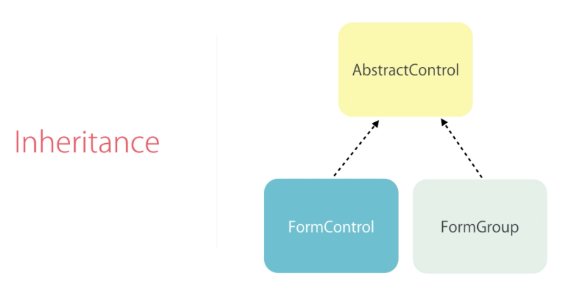
Building a Bootstrap Form
  Inheritance:

Slide 5
Create Controls Programmatically
  add FormGroup:
  signup-form.component.ts: (add)
  form = new FormGroup({
  username: new FormControl(),
  password: new FormControl()
  });
  signup-form.component.html: (add)
  [formGroup]="form”
  formControlName="username"
  app.module.ts: (add)
  ReactiveFormsModule

Slide 6
Add Validation
  add validations:
  signup-form.component.ts:
  username: new FormControl('', Validators.required),
  password: new FormControl('', Validators.required)
  signup-form.component.html: (add)
  <div *ngIf="form.get('username').touched && form.get('username').invalid"
  class="alert alert-danger">Username is required.</div>

Slide 7
Add Validation
  specific validation errors:
  signup-form.component.ts:
  username: new FormControl('', [
  Validators.required,
  Validators.minLength(3)
  ]),
  signup-form.component.html:
  <div *ngIf="username.errors.required">Username is required.</div>
  <div *ngIf="username.errors.minlength">Username should be minimum {{ username.errors.minlength.requiredLength }} characters.</div>

Slide 8
Implement Custom Validation
  create username.validators.ts
  username.validators.ts:
  export class UsernameValidators {
  static cannotContainSpace(control: AbstractControl) : ValidationErrors | null {
  if( (control.value as string).indexOf(' ') >= 0 ) {
  return { cannotContainSpace: true };
  }
  return null;
  }
  }

Slide 9
Implement Custom Validation
  signup-form.component.ts: (add)
  UsernameValidators.cannotContainSpace
  signup-form.component.html: (add)
  <div *ngIf="username.errors.cannotContainSpace">Username cannot contain space.</div>

Slide 10
Asynchronous Validation
  username.validators.ts:
  static shouldBeUnique(control: AbstractControl) : ValidationErrors | null {
  if( control.value === 'James' ) {
  return { shouldBeUnique: true };
  }
  return null;
  }

Slide 11

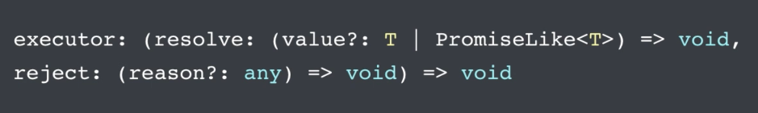
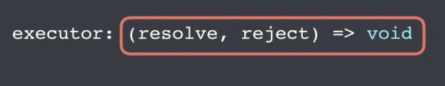
Asynchronous Validation

Slide 12
Asynchronous Validation
  username.validators.ts:
  static shouldBeUnique(control: AbstractControl) : Promise<ValidationErrors | null> {
  return new Promise( (resolve, reject) => {
  setTimeout(() => {
  if( control.value === 'James' ) {
  resolve({ shouldBeUnique: true });
  } else {
  resolve(null);
  }
  }, 2000);
  });
  }

Slide 13
Asynchronous Validation
  signup-form.component.ts: (add)
  UsernameValidators.shouldBeUnique
  signup-form.component.html: (add)
  <div *ngIf="username.errors.shouldBeUnique">Username is already taken.</div>
  signup-form.component.ts: (add)
  UsernameValidators.shouldBeUnique

Slide 14
Asynchronous Validation
  showing a loader image:
  signup-form.component.html:
  <div *ngIf="username.pending">Checking for uniqueness...</div>

Slide 15
Validate form input upon submit
  validate form input upon submit:
  signup-form.component.html:
  (ngSubmit)="login()”
  <div *ngIf="form.errors" class="alert alert-danger">
  The username or password is invalid.
  </div>
  signup-form.component.ts: (add)
  login() {
  this.form.setErrors({
  invalidLogin: true
  });
  }

Slide 16
Build group forms
  Nested FormGroups:
  signup-form.component.ts:
  account: new FormGroup({
  username: new FormControl('', [
  Validators.required,
  Validators.minLength(3),
  UsernameValidators.cannotContainSpace], [
  UsernameValidators.shouldBeUnique]),
  password: new FormControl('', Validators.required)
  })
  return this.form.get('account.username');

Slide 17
Build group forms
  Nested FormGroups:
  signup-form.component.html: (add)
  <div formGroupName="account">
  </div>

Slide 18
Build group forms
  FormArray:
  ng g c new-course-form
  new-course-form.component.html: (add)
  <form>
  <input
  type="text" class="form-control"
  (keyup.enter)="addTopic(topic)" #topic>
  </form>

Slide 19
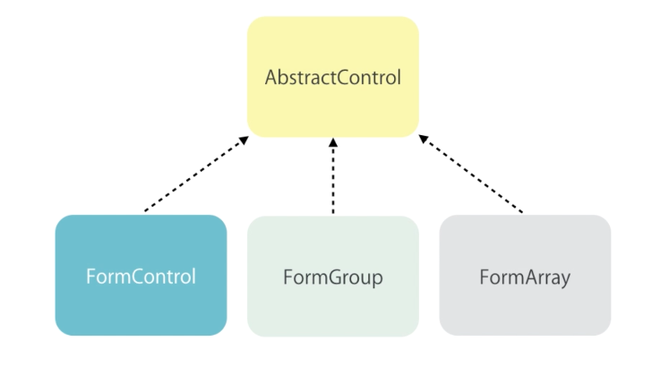
Build group forms
  FormArray:

Slide 20
Build group forms
  FormArray:
  new-course-form.component.ts: (add)
  addTopic(topic: HTMLInputElement) {
  (this.form.get('topics') as FormArray).push(new FormControl(topic.value));
  topic.value = '';
  }

Slide 21
Build group forms
  FormArray:
  new-course-form.component.html: (add)
  <ul class="list-group">
  <li *ngFor="let topic of form.get('topics').controls"
  class="list-group-item">
  {{ topic.value }}
  </li>
  </ul>

Slide 22
Build group forms
  FormArray remove topic:
  new-course-form.component.ts: (add)
  removeTopic(topic: FormControl) {
  let index = this.topics.controls.indexOf(topic);
  this.topics.removeAt(index);
  }

Slide 23
Build group forms
  FormBuilder:
  new-course-form.component.ts: (add)
  constructor(fb: FormBuilder) {
  this.form = fb.group({
  name: ['', Validators.required],
  contact: fb.group({
  email: [],
  phone: []
  }),
  topics: fb.array([])
  });
  }

Slide 24
Summary

